Slide 1



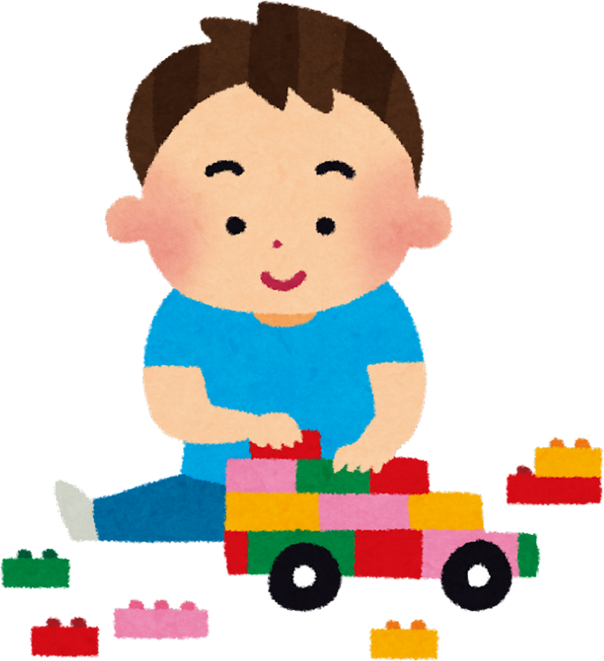


Maven Toys Sales Analysis
- by Fareen Maulavi

Slide 2

CONTENTS
INTRODUCTION
OBJECTIVES
DATA EXPLORATION AND ANALYSIS
DATABASE SCHEMA
SOLUTIONS TO QUESTIONS
COCNLUSION

Slide 3

INTRODUCTION
In this project, we aim to analyze toy sales data from a hypothetical retail company. The data is spread across four key tables: inventory, products, sales, and stores. Each table provides valuable information about the stock levels, product details, sales transactions, and store operations.
Through this analysis, we aim to help the company understand its sales trends, manage stock levels more effectively, and identify the best and worst-performing stores and products. Ultimately, this will assist in making data-driven decisions that will enhance overall operational efficiency.

Slide 4

OBJECTIVES
The primary objective of this project is to conduct a thorough analysis of the toy sales data to provide insights into various aspects of the business. Specifically, we aim to:
Evaluate total sales revenue generated by each store.
Identify top-selling products and measure their performance across different product categories.
Analyze inventory levels and detect products that are out of stock or not.
Track monthly sales trends across stores and sales growth over time.
Determine the profit margin for each product by comparing sales and product costs.
Assess store performance based on opening date.
Compare sales performance to current stock levels .
Evaluate how sales contributions are distributed across stores and product categories.

Slide 5
DATA EXPLORATION AND ANALYSIS
Import data
Find any missing values.
use aggregate functions such as avg, sum, count
use Join clause to fetch data from different tables, based on related column between them.
use round() to round specific number of decimal, In my analysis it is 4.
use conditional statement such as where.
use window function such as lag for accessing the previous row of the data.
group and sort data using group by and order by statement
use cte(Common Table Expression) to store the results of the subquery, so we can reuse them throughout a larger query.
use of Limit to display the number of rows we want in our result.

Slide 6
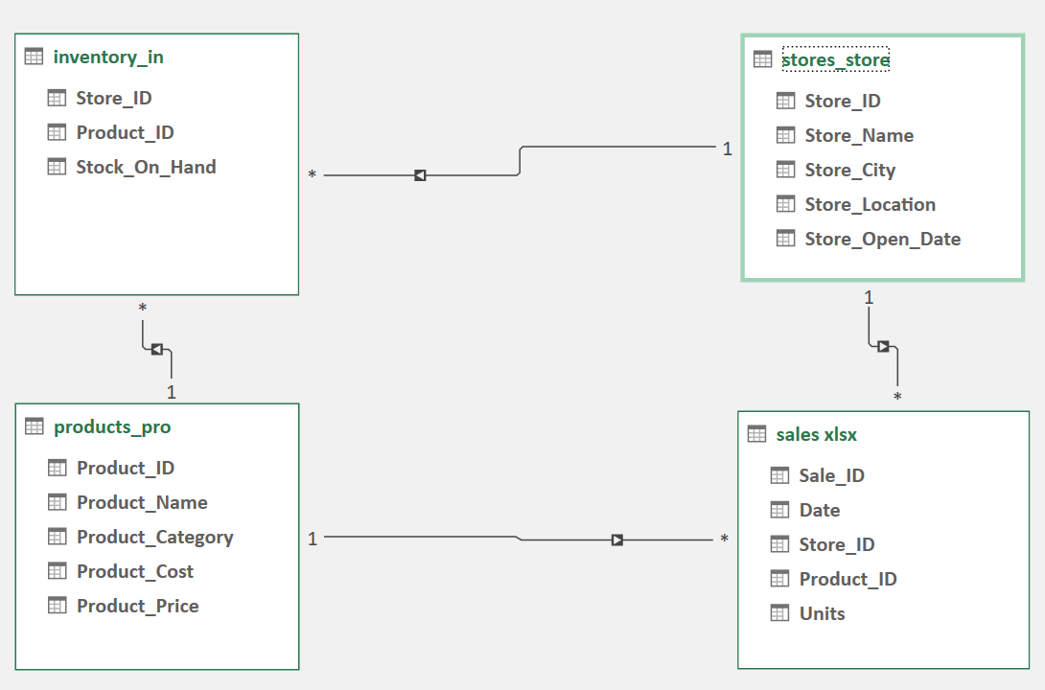

DATABASE SCHEMA

Slide 7
Lets walk through the SQL solutions to answer key business questions.

Slide 8
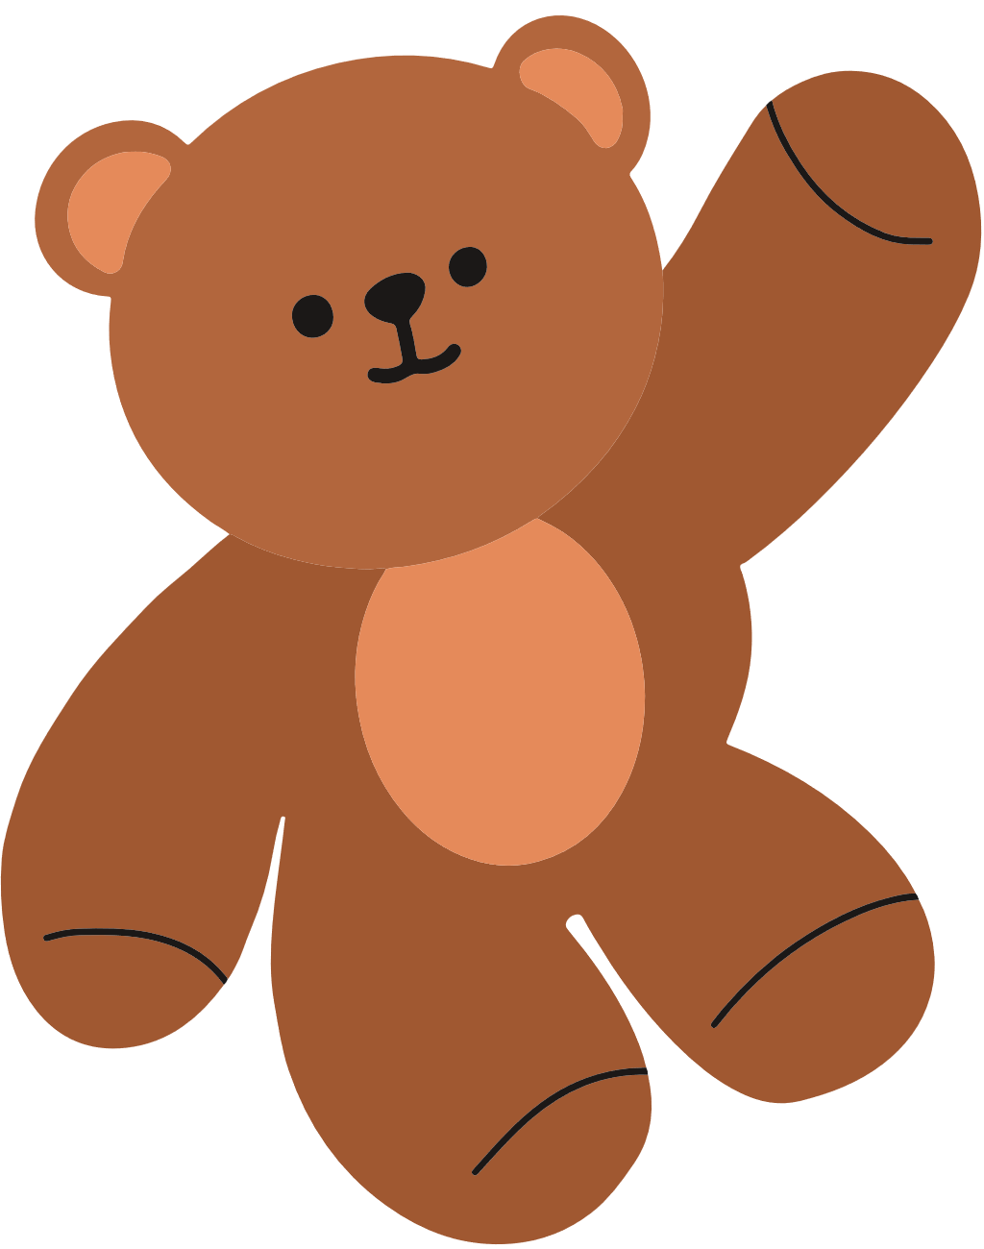
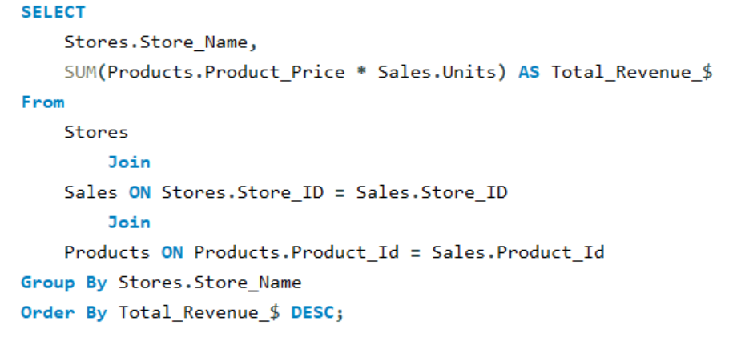
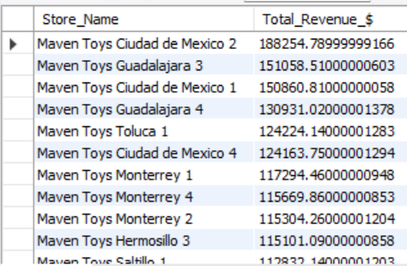
1. What is the total sales revenue generated by each store?

Slide 9

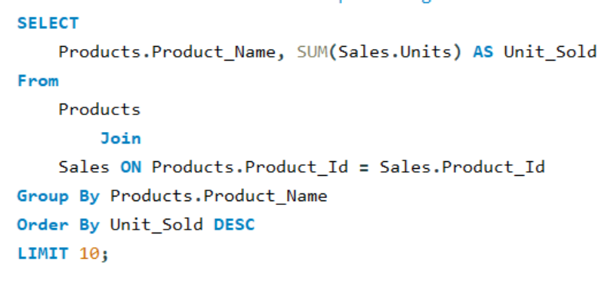
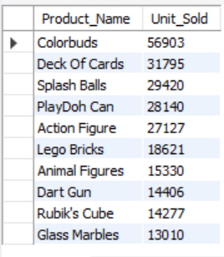
2. Which products are the top-selling in terms of units sold?

Slide 10
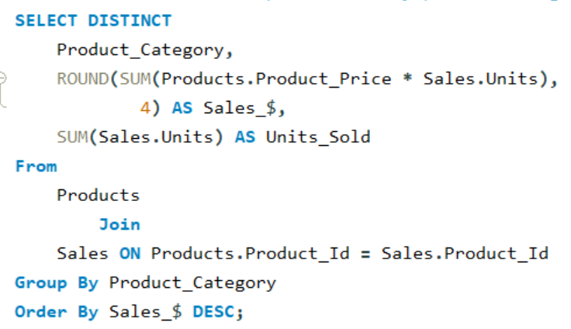

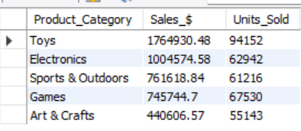
3. What is the sales performance by product category?

Slide 11
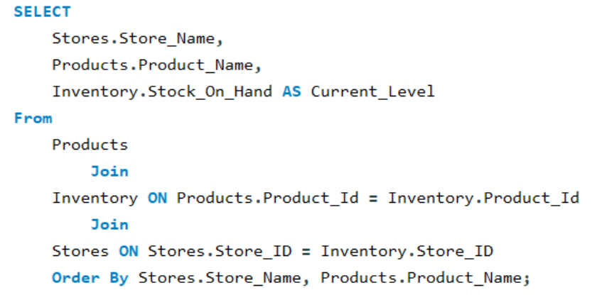
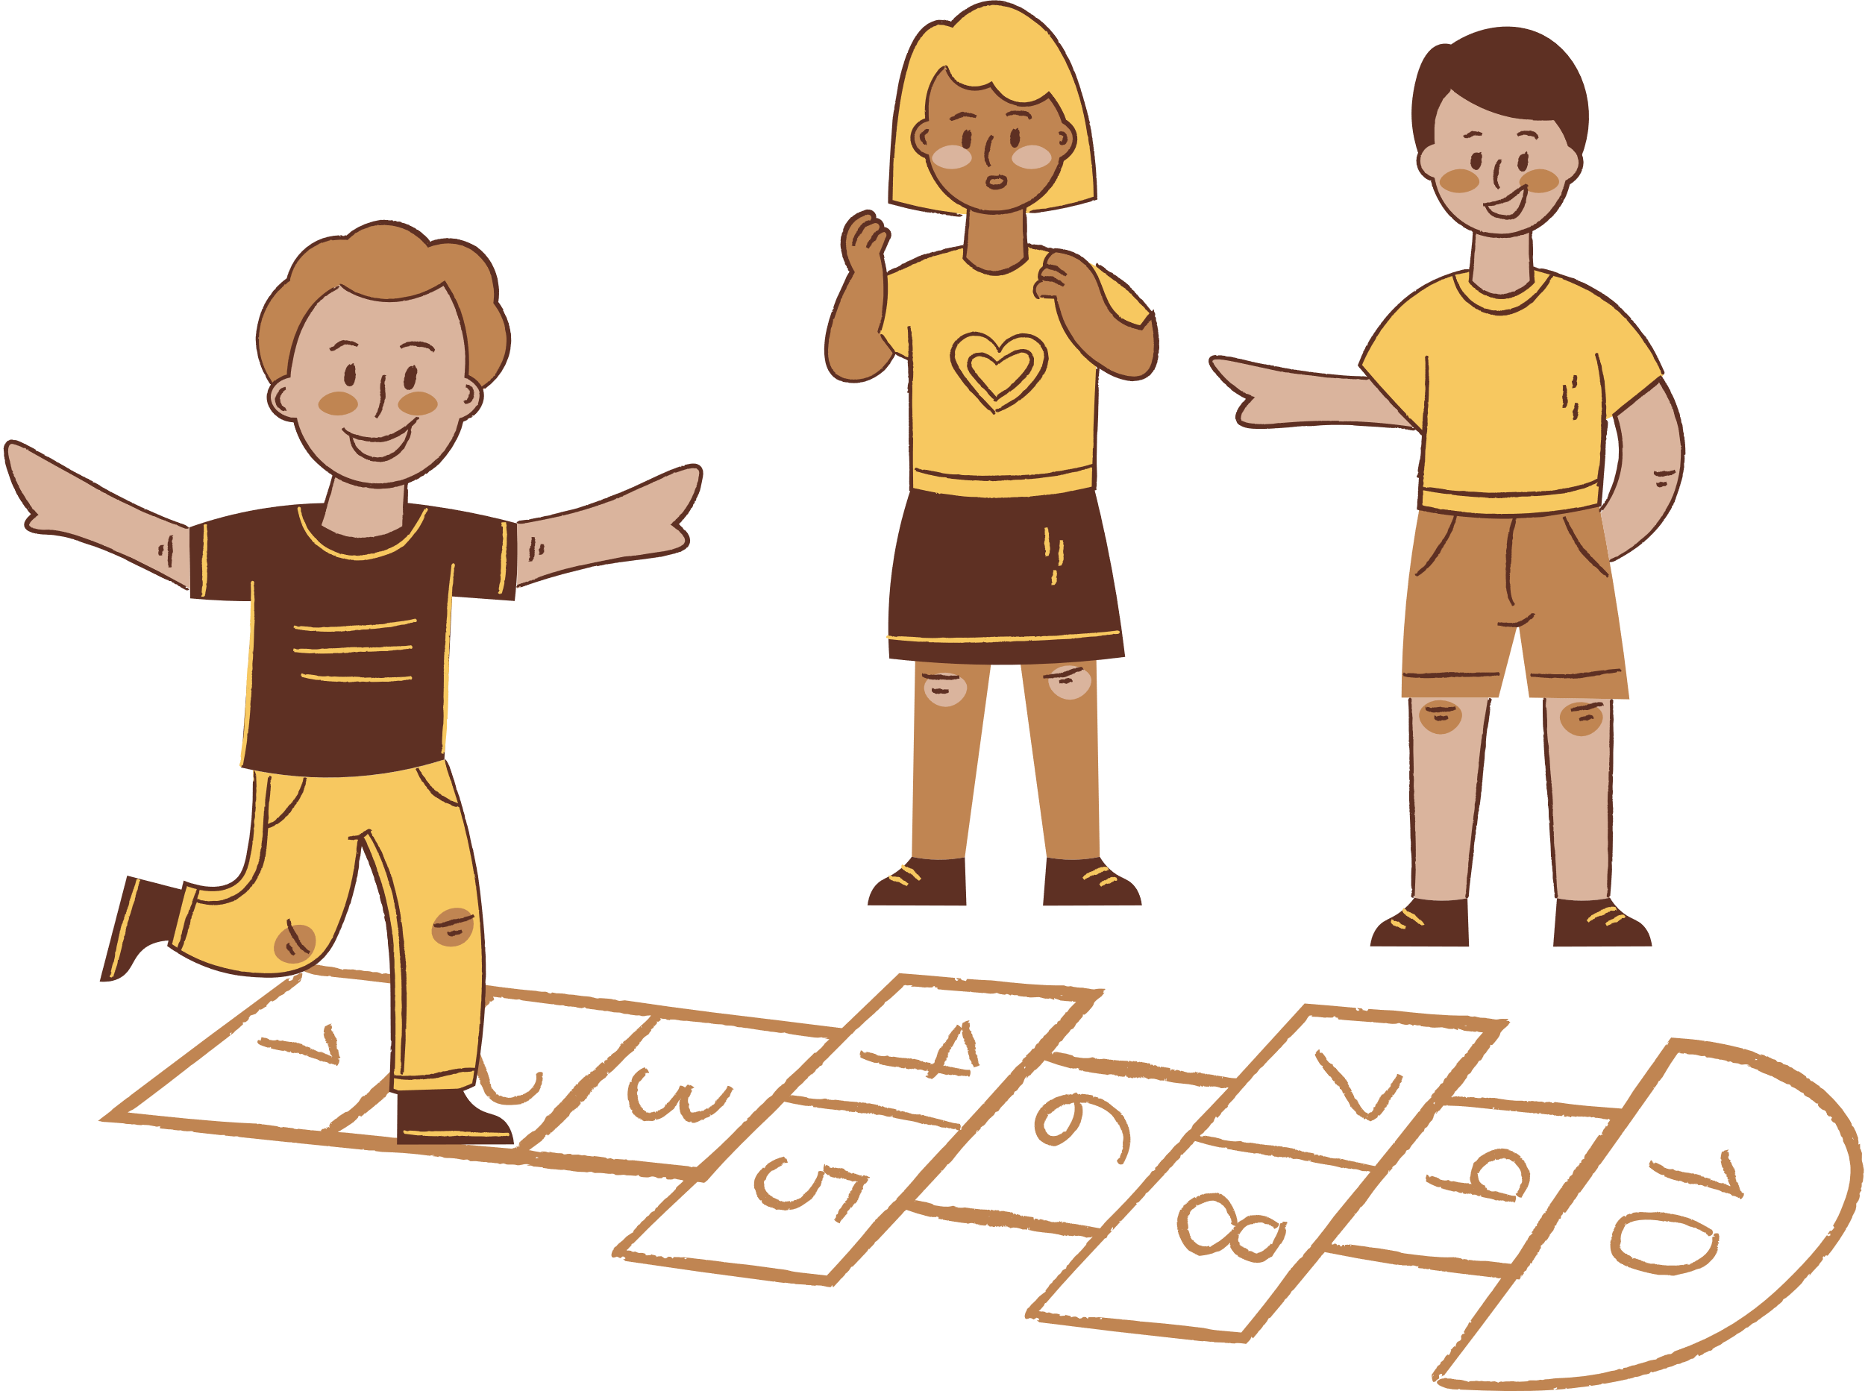
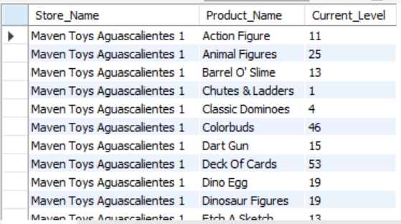
4. What are the current inventory levels for each product at each store?

Slide 12
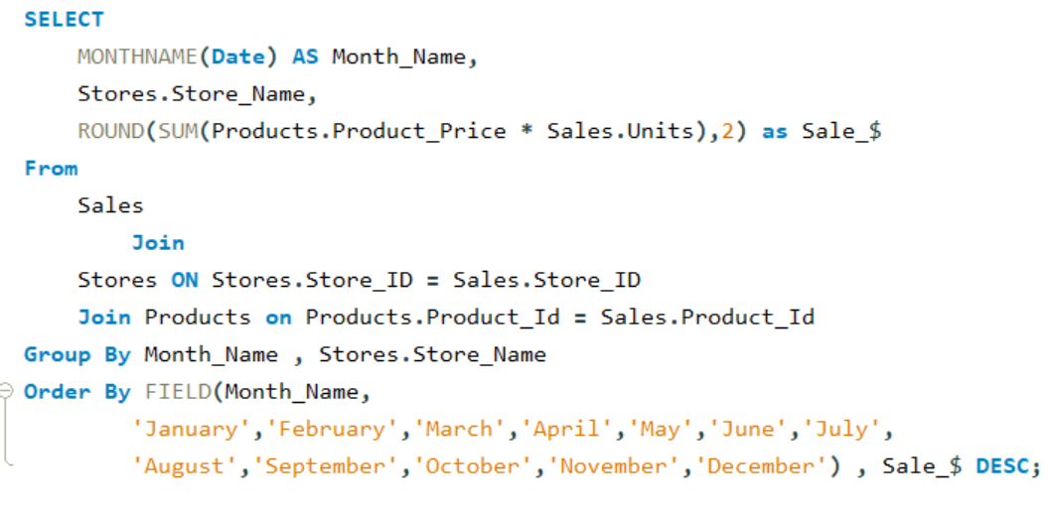
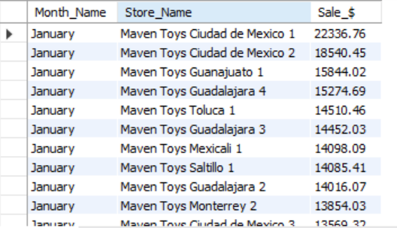

5.How do monthly sales trends vary across different stores?
TOY STORE

Slide 13
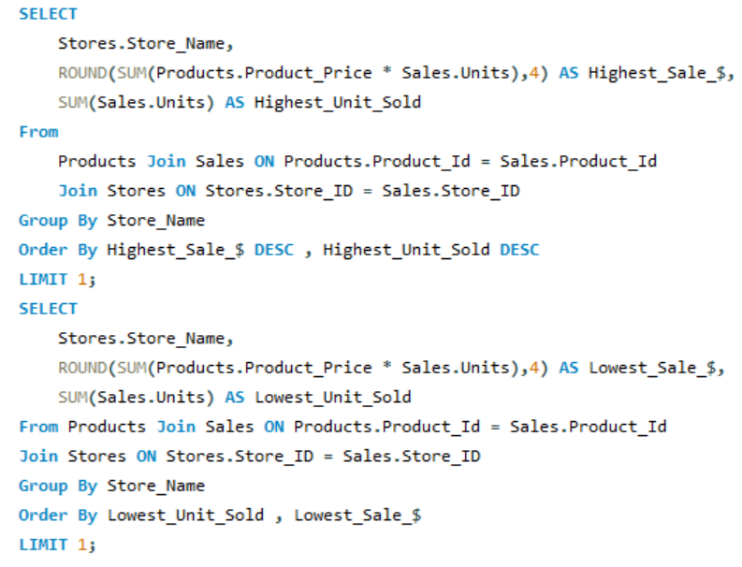

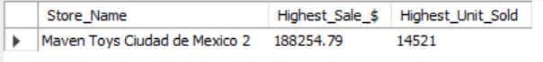
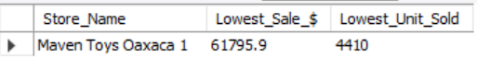
6.Which stores have the highest and lowest sales performance?

Slide 14
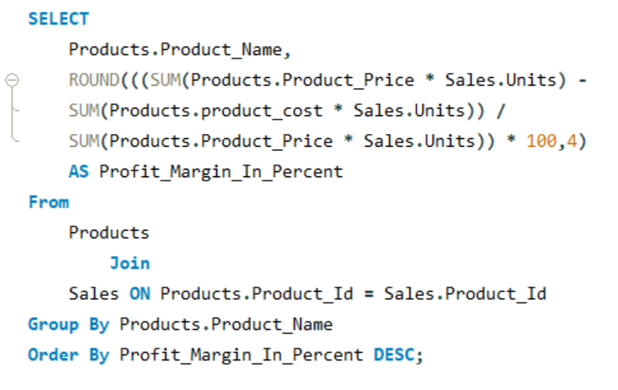

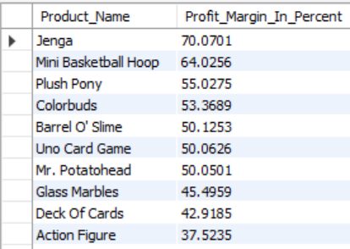
7. What is the profit margin for each product?

Slide 15

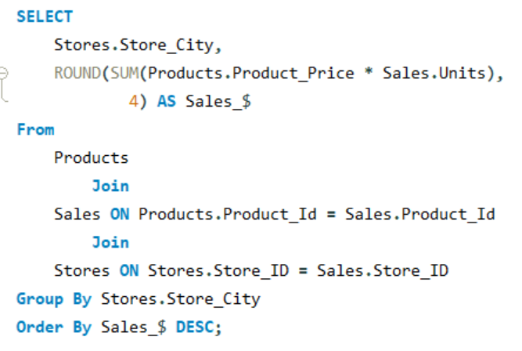
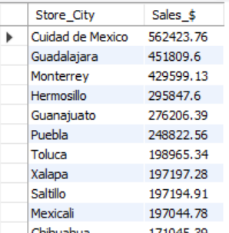
8.How are sales distributed across different cities?

Slide 16
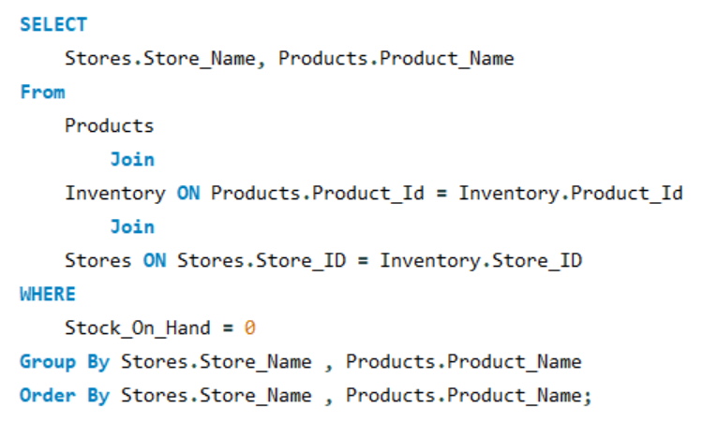

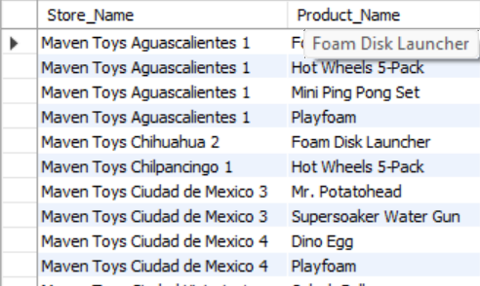
9.Which products are out of stock in each store?

Slide 17

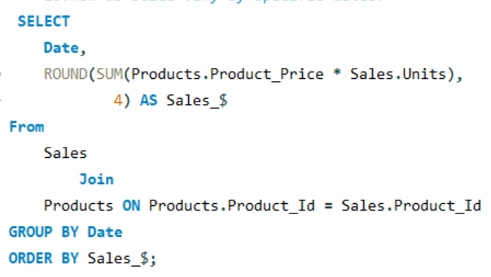
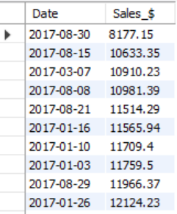
10.How do sales vary by specific dates?

Slide 18
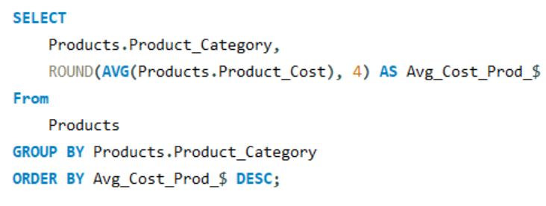
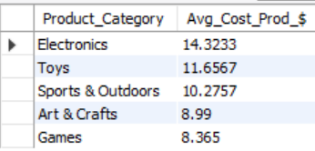

11.What is the average cost of products in each category?

Slide 19
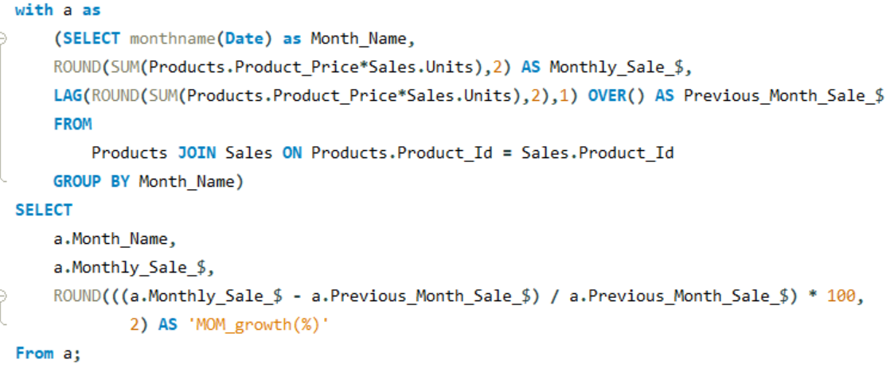
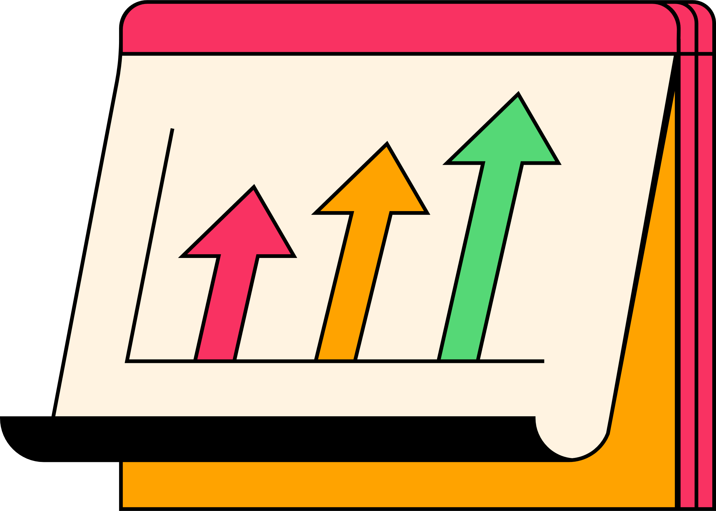
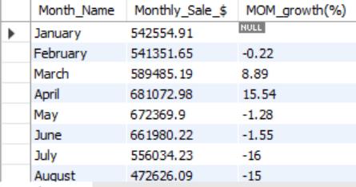
12.What is the sales growth over time for the entire company?

Slide 20
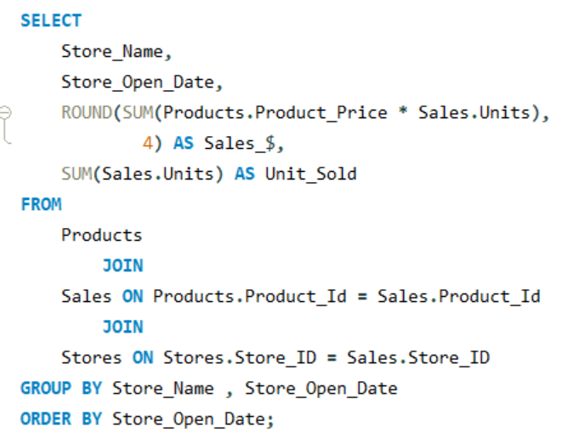


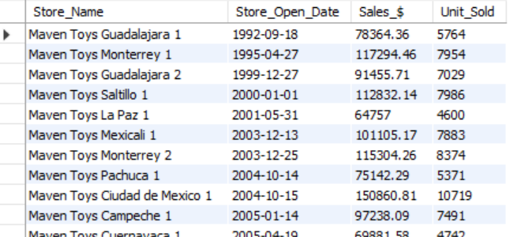
13.How does the store open date affect sales performance?

Slide 21
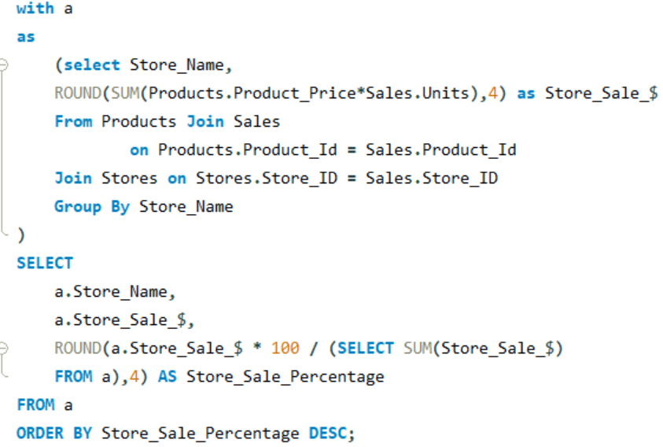
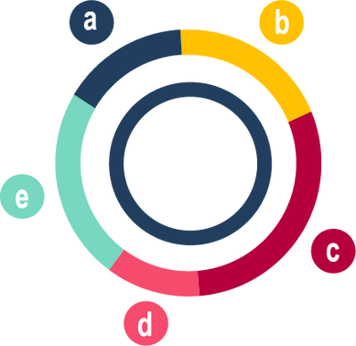
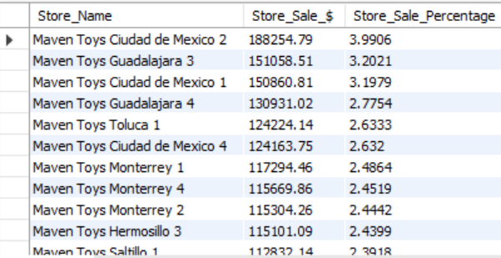
14.What percentage of total sales does each store contribute?

Slide 22
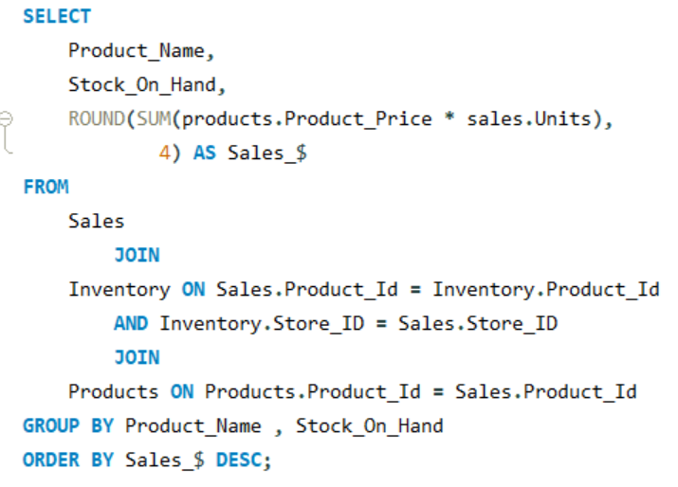

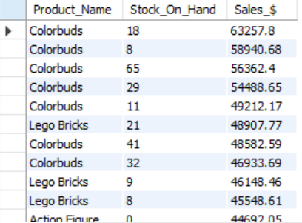
15.How do sales compare to current stock levels for each product?

Slide 23
CONCLUSION
Top Revenue Store: Maven Toys Ciudad de Mexico 2 leads with the highest revenue.
Best-Selling Product: Colorbuds is the top-selling product by units sold.
Key Revenue Categories: Toys and Electronics drive the most revenue, warranting focused marketing, while underperforming categories may need adjustments.
Inventory Management: Stock levels show whether stores can meet demand and avoid stockouts.
Sales Performance: Maven Toys Ciudad de Mexico 2 has the highest sales ($188,254.79), while Maven Toys Oaxaca 1 has the lowest sales ($61,795.90).
Profit Margins: Jenga offers the highest profit margin, while Dino Egg may need cost adjustments.
City Sales Distribution: Cuidad de Mexico records the highest sales distribution.
Stock Shortages: Addressing out-of-stock items can boost customer satisfaction and sales.
Sales Growth: Positive overall sales growth indicates effective strategies, with declines signaling areas for improvement.
Top Sales Contributor: Maven Toys Ciudad de Mexico 2 contributes the largest percentage of total sales.

Slide 24



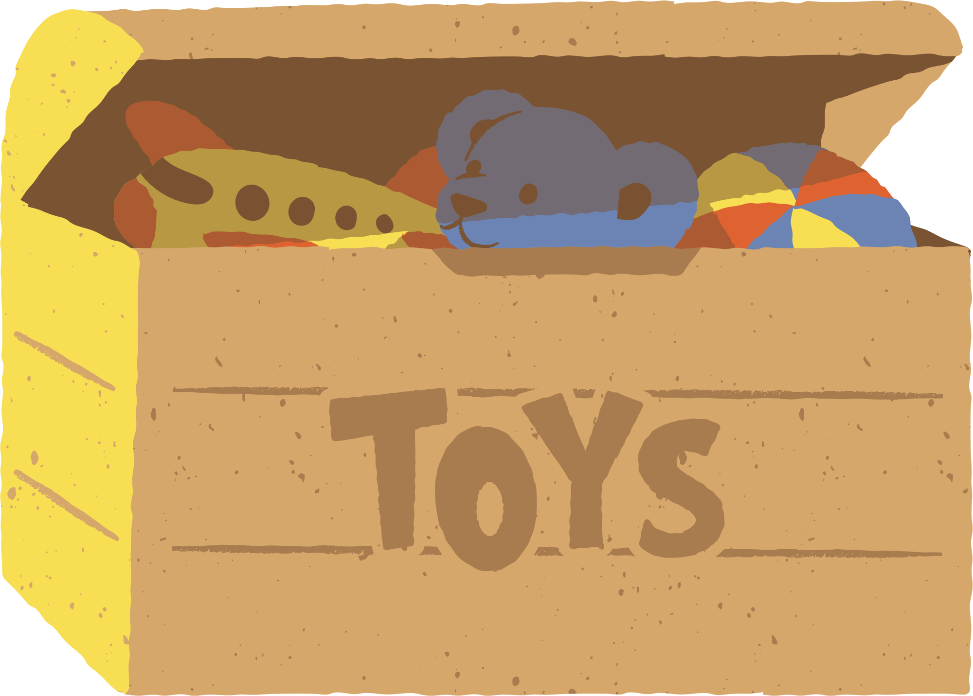
https://www.linkedin.com/in/fareen-maulavi
https://www.github.com/fairy-the-analyst

